Slide 1


WRTG393: Final Assessment Presentation for Mr. Chris taylor of LAWN & ORDER services.
Mark Kardash

Slide 2
The Current Situation Part 1:
Since its foundation, Lawn & Order has been allowing only one individual in each department to access certain online features. While this has so far proven quite effective, our operations can be optimized even more, by addressing the following circumstances:

Slide 3
The Current Situation Part 2:
Access to our client database was only given to Jack Wilkinson, who uses a password and ID provided by the IT firm CloudSecure.
Sandra Adams is the only employee with access credentials to Lawn & Order’s WordPress-based website.
Marsha Davis’s absence or exit could leave the company without its WordPress-based blog, her being the only one with access to it.
Jared Quinn is the only one with access to payroll data, guarding all the employee salary information.

Slide 4
Potential Issues to Prevent:
Over the last 12 years, our company has experienced significant growth. To maintain this progress, there are some scenarios we must prevent:
Mr. Wilkinson is absent/has left the company-Client information access restricted-Unable to take orders-Working Routine Disrupted.
Ms. Davis has a medical emergency-Blog access restricted-Unable to advertise products/services.
Ms. Adams leaves the company-Website inaccessible-Customers unable to order online/view updates.
Mr. Quinn is absent-Salary database not available-Employees cannot be paid.
Any disgruntled employee could use their access to software against the company.

Slide 5
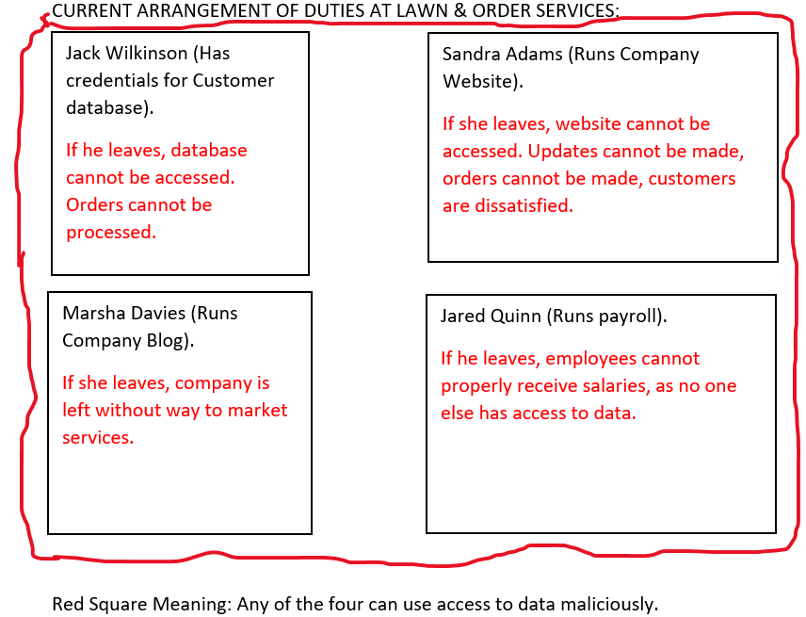
Current Arrangement Issues Graphic:

Slide 6
Potential Solution 1: Separation of Duties
Giving data to multiple individuals will prevent it from both being lost and used maliciously.
Both Sandra Adams and Marsha Davis could have access to each other’s workspaces, in addition to their own.
Both Jared Quinn and Jack Wilkinson could have access to each other’s workspaces, to step in for one another should the need arise. CloudSecure could be notified of their mutual permission for software use.

Slide 7
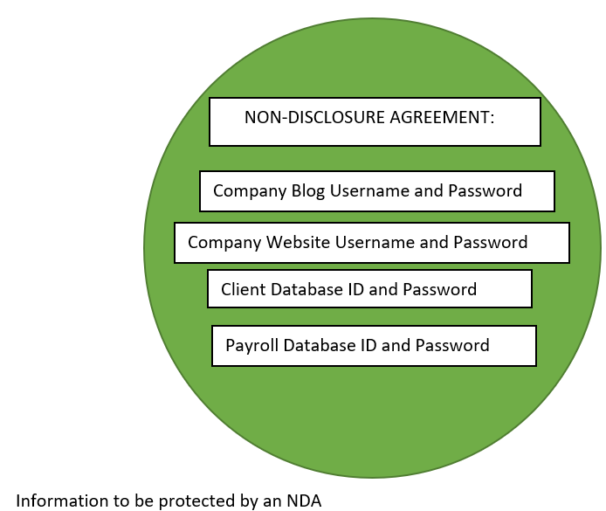
Potential Solution 2: NDA Agreements
Prevents data from falling into hands of competitors.
Must be clear and detailed enough to understand, but not reveal confidential information (Techvice.com).
Employees must not disclose company information to relatives, non-work friends, neighbors, and competitors.
Monetary fine to be paid for violation.

Slide 8
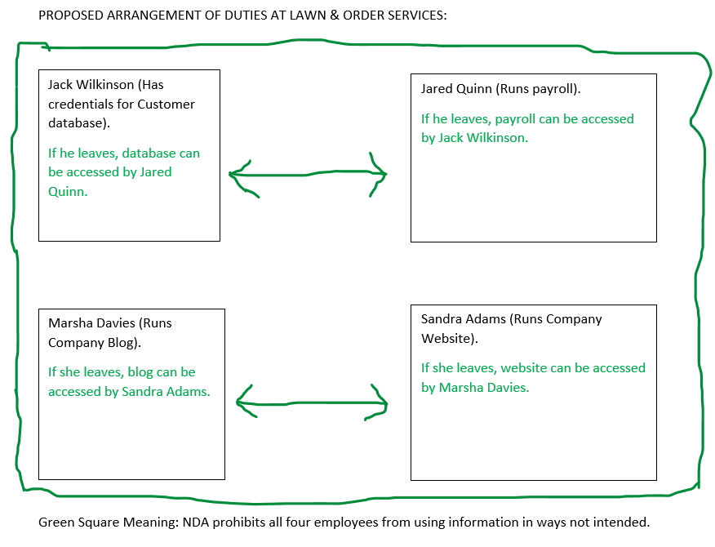
Potential Solution 3: Job Rotation
Reduces the stress put on employees when dealing with a particular task.
Ms. Davis could start learning to run the website, and Ms. Adams the blog (Familiarity with Wordpress will make it easier for them.
Jack Wilkinson can undergo training to oversee payroll, while Jared Quinn could be made familiar with our customer database.

Slide 9
References:
California Department of General Services. (2020, August). Separation of duties. DGS. https://www.dgs.ca.gov/Resources/SAM/TOC/7200/7280
What is NDA and why you should know about it. (2021, July 30). Techvice. Retrieved November 22, 2022, from https://techvice.org/blog/management/all-you-need-to-know-about-nda/
What Is a Job Rotation? A Guide for Managers. (n.d.). Indeed.com. Retrieved November 22, 2022, from https://www.indeed.com/hire/c/info/job-rotation

